Slide 1
Deep Learning Tuberculosis Prediction from Chest X-Rays

Slide 2
Introduction
Tuberculosis (TB) is a bacterial infection spread through inhaling tiny droplets from the coughs or sneezes of an infected person. It mainly affects the lungs, but it can affect any part of the body, including the tummy (abdomen), glands, bones and nervous system.
Tuberculosis (TB) was called “phthisis” in ancient Greece, “tabes” in ancient Rome, and “schachepheth” in ancient Hebrew. In the 1700s, TB was called “the white plague” due to the paleness of the patients. TB was commonly called “consumption” in the 1800s even after Schonlein named it tuberculosis. During this time, TB was also called the “Captain of all these men of death.”
Due to detection of Tuberculosis using deep learning, we can get an impartial result unlike in case of significant intra- and inter-observer variations in the interpretation of CXR, resulting in misdiagnosis of TB . Also due to how expensive it is to hire a radiologist and due to their low availability , making a machine learning model that predicts whether a person has tuberculosis or not is more suited and appropriate.

Slide 3
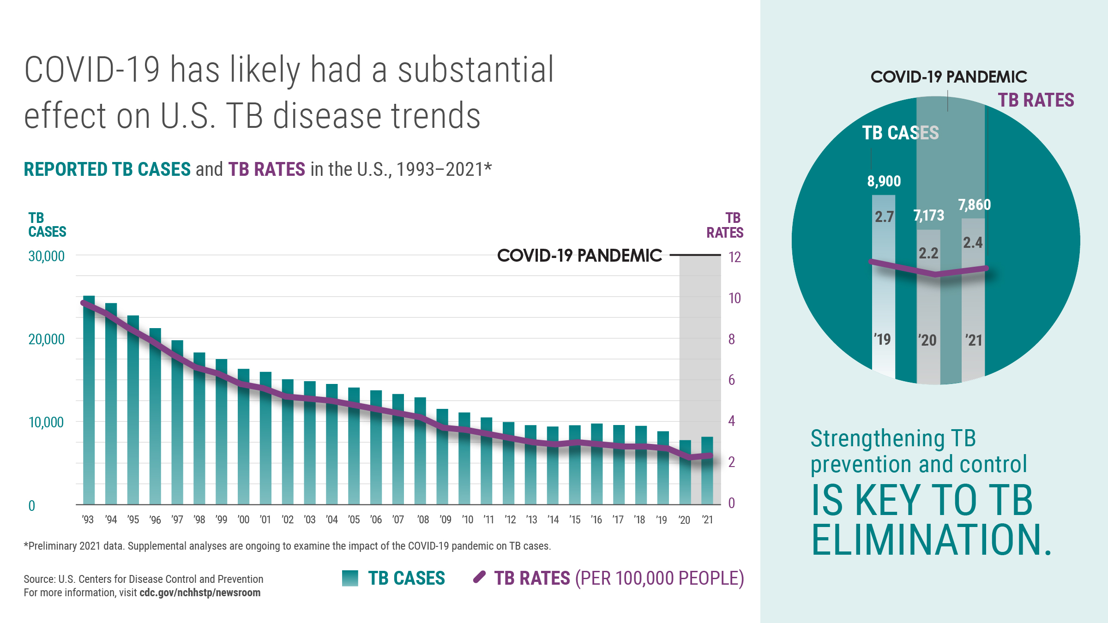
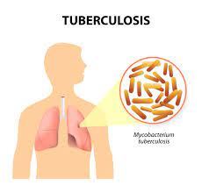
Tuberculosis is an ancient scourge. It has plagued humankind throughout known history and human prehistory. It has surged in great epidemics and then receded, thus behaving like other infectious diseases, but with a time scale that challenges accepted explanations for epidemic cycles. Mycobacterium tuberculosis may have killed more persons than any other microbial pathogen.
Deep learning is a machine learning algorithm that teaches computers to perform tasks that humans typically perform: learning through examples and real-life experiences. Deep learning is a key component of the technology that allows driverless cars, among other things, to detect a stop sign or signal or to distinguish between a pedestrian and a lamppost.
Artificial intelligence can be a useful tool in the early detection of tuberculosis. Artificial intelligence can assist in predicting patients who are at high risk of developing active tuberculosis. This will assist health officials in allocating health resources to a select few. Artificial intelligence can contribute to the ultimate goal of eliminating tuberculosis from the world.

Slide 4
Aims and Objectives
The aim of my research is to propose a CAD model for screening of pulmonary tuberculosis in the targeted high-risk population using chest x-rays. The model aims to shorten the time it takes to identify the deadly disease and streamline decision-making at the first point of care institution by modeling a system that will categorize X-rays into two categories, Tuberculosis or Normal.
To make a reliable deep learning model in order to detect pulmonary tuberculosis using chest x-rays.
Deep learning is used to create a portable health gadget that will enhance TB diagnosis in high-burden nations like India.
The dataset is trained by transfer learning methods such as DenseNet201, Inception V3, ResNet50 and XCeption , Mobile Net, depth based CNN, etc.
The training, testing and validation dataset is created from the original dataset in the ratio 8:1:1.

Slide 5
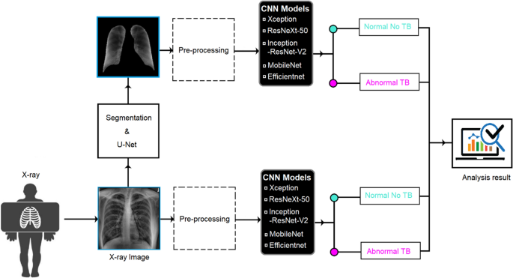
An example of Transfer learning is shown below

Slide 6
Literature Review
Research 1’s best transfer learning model was Xception,ResNet50 and VGG16 with sensitivity, F1-score, precision and AUC 90.0%, 90.0%, and 91.0%, respectively.
Research 2’s best results came from Support Vector Machine which has an accuracy of 0.879 , precision of 0.859, recall of 0.859, f1-score of 0.84 in comparision to Regression logistics(accuracy = 0.808, precision = 0.818, recall = 0.808, f1-score = 0.79), K-neighbours(accuracy = 0.758, precision= 0.778, recall= 0.758, f1-score = 0.74).
For Research 3: The Score-CAM visualization method was used to demonstrate the fact that models learn from the segmented lung areas and produce tuberculosis diagnosis results with high precision, accuracy, and sensitivity, namely 97.34%, 97.07%, and 97.07%, respectively.
Research 4: of 662 X-Rays in the Shenzhen Dataset. A total 326 normal images and 336 abnormal images among them. There are 138 CXRs in the Montgomery Country X-ray Set. There are 80 normal x-ray images and 58 abnormal x ray images. Each image has three color channels. DenseNet-169 is the best model for training the data set. The accuracy of the DenseNet-169 validation is 91.67%. The lowest accuracy which is obtained using the Xception architecture from the validation set comes as 87.08%. Although both InceptionV3 and Mobile Net provided 90% accuracy for dataset, however, their precision and recall values were different. The AUC for Mobile Net and Inception-v3 architecture was 0.907.
Research 5: The dataset includes 700 TB images as well as 3500 normal images. The models used here are InceptionV-3, VGG-19, ResNet50, and XCeption. Despite the fact that models like InceptionV3, ResNet50, and Xception produced nearly identical accuracy, ResNet50 outperformed others in terms of time consumption, loss rate, and accuracy (98%). 3360 images were used for training and the remaining images for validation and testing for each model. Sensitivity=0.93, Specificity=0.89

Slide 7
Research 6: The pre-trained EfficientNet-B4 model can generate more stable outcomes in enhanced images when employing the HEF and UM approaches. The result accuracy of the pre-trained EfficientNet-B4 is 89.92.
Research 7: Three publicly available datasets courtesy of the NLM which stands for National Library of Medicine, the National Institute of health, ChestX-ray14, Montgomery, Maryland, and Shenzhen, China. Sets of external tests from Montgomery and Shenzhen were used to assess the efficacy of our models. Three models—ResNet152, Inception-ResNet, and DenseNet121—were applied. Internal ChestX-ray14, the Montgomery testing dataset, and the Shenzhen testing dataset show that DenseNet121 has the greatest AUC, followed by 0.9139 and 0.9384 respectively. Three models—ResNet152, Inception-ResNet, and DenseNet121—were applied. Internal ChestX-ray14, the Montgomery testing dataset, and the Shenzhen testing dataset show that DenseNet121 has the greatest AUC, followed by 0.9139 and 0.9384 respectively.
Research 8: The model used in this case is ResNet 50. The training-to-validation ratio was kept at the widely accepted 80:20 percent. Dropout is 0.25, image batch size is 16, image size is 299*299, learning rate is 0.01 and the last fully connected layers were trained over three epochs (FCL). The specificity is 90% and the sensitivity is 95%. The accuracy of the model is 94.8%.
Research 9 : The Resnet 50 Shenzhen AUC has been the highest 0.99

Slide 8
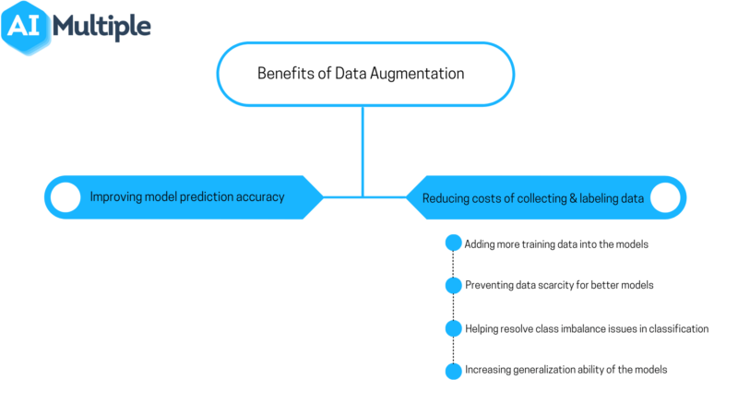
Methodology
Images come from collaboration of Hamad Medical Team , Bangladesh, Qatar university and Malaysia. There are 700 Tuberculosis Images and 3500 Normal Images.
The data was divided into training, testing, and validation datasets in the ratio of 8:1:1.
Data Augmentation was used because it randomly applies defined parameters to the train set using the tensor flow. keras. preprocessing. image library, and for the Test & Validation set, I am simply rescaling them to avoid manipulating the test data beforehand. Due to the varying sizes of the input images, the image height and width were both set to 500 * 500 pixels. There will be sixteen in the batch.

Slide 9
The model is made up of 5 Convolutional 2D layers (3 of which extract 32 features and the other two extract 64 features, with all 5 activation layers activating as 'relu'), 5 Max-Pooling Layers with pooling size of (2,2). After Flattening the last layer, 3 Dense Layers are activated with activation as 'relu', with units 128, 64, 1units. The input image has a size of 500 500 pixels.
We trained the suggested models with the Adam optimizer and categorical cross-entropy loss function to reduce the dimension of the retrieved features. For training, the following solver parameters were used: epoch of 25, minimum learning rate of 0.00001, batch size of 16.

Slide 10
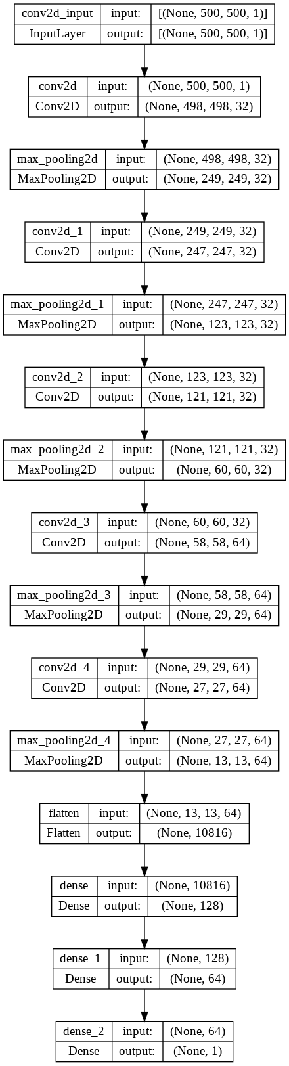
The structure of the CNN model is shown below

Slide 11
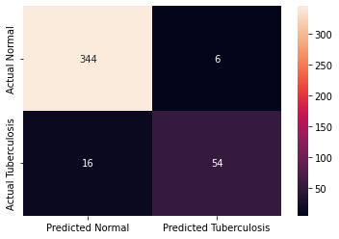
Result and Discussion
Sensitivity of my model is: 0.95
Specificity of my model is: 0.90
Accuracy of my model is: 0.94
Both sensitivity and specificity are above the WHO standards of having at least 90% sensitivity and at least 70% specificity.
Sensitivity of 95%, Specificity of 90%. My model’s precision in predicting Normal is 0.96 and it is 0.90 in Predicting Tuberculosis. The recall for normal is 0.98 and 0.77 in case of Tuberculosis. The f1-score for Normal is 0.97 and 0.83 for Tuberculosis. The support for Normal is 350 and 70 for Tuberculosis.

Slide 12
The statistics of my model which consist of precision, accuracy, recall and f1 score and shown below
In hyperparameter tuning, I added BatchNormalization and Dropouts. It improves the learning speed of Neural Networks and provides regularization, avoiding overfitting. Batch Norm is a normalization technique done between the layers of a Neural Network instead of in the raw data. Batch Norm reduces the internal covariate shift of the network. The Dropout layer is a mask that nullifies the contribution of some neurons towards the next layer and leaves unmodified all others. We can apply a Dropout layer to the input vector, in which case it nullifies some of its features; but we can also apply it to a hidden layer, in which case it nullifies some hidden neurons. The amount of change in the distribution of the input of layers is reduced. The deeper layers have a more robust ground on what the input values are going to be, which helps during the learning process.
Lastly, it seems that Batch Norm has a regularization effect. This can act as a regularizer, which can help overcome overfitting and help learn better. However, the noise added is quite small. Thus, it generally is not enough to properly regularize on its own and is normally used along with Dropout.
Dropout layers are important in training CNNs because they prevent overfitting on the training data. If they aren’t present, the first batch of training samples influences the learning in a disproportionately high manner.
The Dropout layer is a mask that nullifies the contribution of some neurons towards the next layer and leaves unmodified all others. We can apply a Dropout layer to the input vector, in which case it nullifies some of its features; but we can also apply it to a hidden layer, in which case it nullifies some hidden neurons.
Dropout layers are important in training CNNs because they prevent overfitting on the training data. If they aren’t present, the first batch of training samples influences the learning in a disproportionately high manner.
I have added a Dropout with parameter of 0.3 alongside Batch Normalization.
I have achieved a Sensitivity of 94% and a Specificity of 82%, both parameters surpass the WHO guidelines of having greater than or equal to 90% Sensitivity and having greater than or equal to 70% Specificity.
 | precision | recall | F1-score | Support
NORMAL | 0.96 | 0.98 | 0.97 | 350
TUBERCULOSIS | 0.90 | 0.77 | 0.83 | 70
Accuracy |  |  | 0.95 | 420
Marco avg | 0.93 | 0.88 | 0.90 | 420
Weighted avg | 0.95 | 0.95 | 0.95 | 420

Slide 13
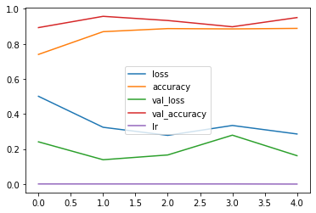
As seen below, the validation accuracy after rising, ends up having a gradual decline. The Accuracy of the model has a not so steep increase and having a slightly steep increase. The loss decrease as the model training approaches its end. The learning rate just like the accuracy of the model remains stagnant.

Slide 14
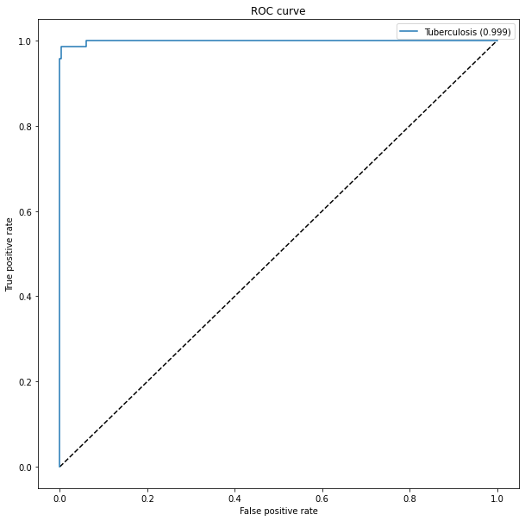
The Xception model was the Transfer Learning Model used for modified transfer learning. A Global Average Pooling Layer alongside a Dense Layer with activation type sigmoid was added into it thus putting the last layer as false. The Area Under Curve was 0.995. The accuracy of the model was calculated as 94%. It achieved a sensitivity of 97% and a specificity of 100%.
I achieved a sensitivity of 97 % and a specificity of 100%.The accuracy of the model is 97%.Below is the Area Under Curve of the XCeption model is 0.99 as shown below

Slide 15
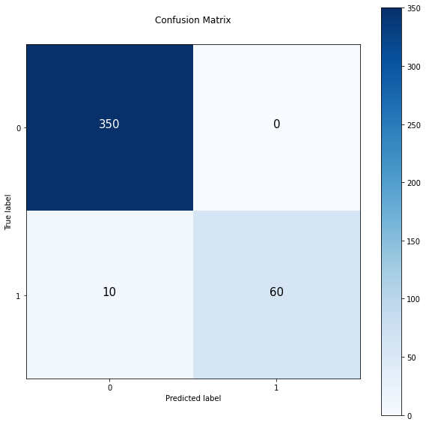
Confusion matrix of Xception model

Slide 16
Comparision of models
Confusion Matrix of Normal CNN model
 | My model | ResNet-50 | ResNet-101 | ResNet-18 | DenseNet-201 | Inception V3
Accuracy | 94.76% | 93.11% | 94.55% | 93.85% | 95.07% | 95.72%
Sensitivity | 98.28% | 93.11% | 94.55% | 93.85% | 95.07% | 95.73%
Specificity | 77.14% | 93.16% | 94.59% | 93.91% | 95.12% | 95.92%
Precision | 95.55% | 93.4% | 94.74% | 94.08% | 95.27% | 95.92%
F1-Score | 96.47% | 93.09% | 94.54% | 93.84% | 95.07% | 95.73%

Slide 17
Conclusion and Future Recommendations
I have come to the conclusion that the models I have made either with hyperparameter tuning or with transfer learning are of great use.
I made a CNN model with 4 pairs of Convolutional Layers alongside Max-pooling. I made the decision to insert Early Stopping so that my model would stop training if the loss would increase after 3 epochs, otherwise training would be extremely time consuming and the model trained would be highly insufficient. The learning rate would change and adjust itself if the learning has stopped improving.
In my opinion, given the fact that Artificial Intelligence and Machine Learning is such a fast growing and innovative field, the improvements would help doctors immensely in detection and cure of Tuberculosis and other diseases such as pneumonia, arthritis etc.

